Slide 1
Federal Labor Relations Authority
FLRA Information Resources
49th NFFE National Convention
October 2, 2012
Portland, Oregon
Julia Akins Clark, General Counsel
Federal Labor Relations Authority

Slide 2
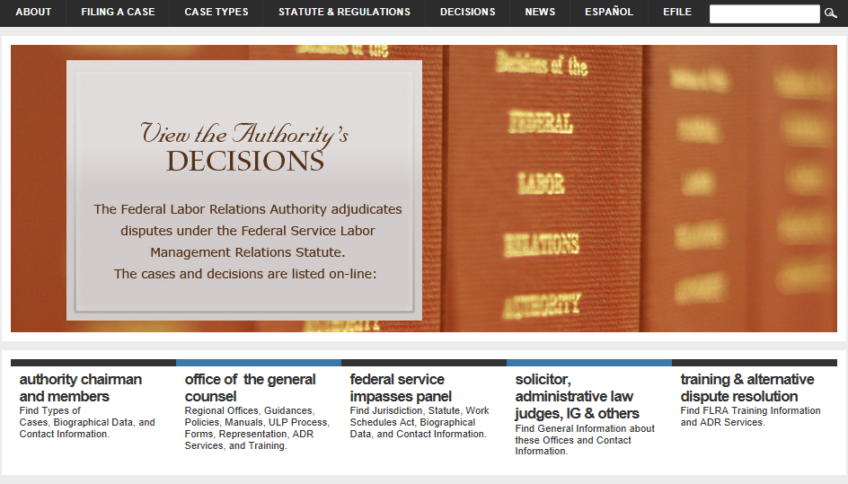
Statute, Regulations, Decisions, Filing Instructions www.flra.gov

Slide 3
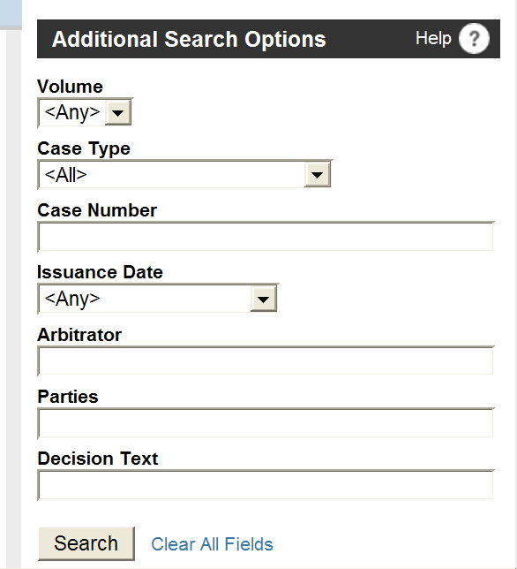
All Decisions Searchable
http://www.flra.gov/authority_decisions

Slide 4
http://flra.gov/eFiling
Set up one account/profile to E-file with:
The Authority
Appeals: Negotiability, Arbitration, etc.
Office of General Counsel
ULP charges and REP Petitions
Federal Service Impasses Panel
FLRA Inspector General
Freedom of Information Act (coming soon)

Slide 5
OGC Web Pages

Slide 6
http://flra.gov/ogc

Slide 7
ULP Case Law Guide

Slide 8
Live Training Courses
Basic and Advanced Statutory Training
Training on Specific Subjects, e.g., Information Requests
Representation Case Training
FLRA OGC/FMCS E.O. 13522 Training
FLRA 7106(b)(1) Pilot Project Training
OGC trained 14,000 individuals in last 36 months

Slide 9
Web-Based Interactive Training
In cooperation with VA and DOD
E.O. 13522 Training
7106(b)(1) Training
Basic Statutory Training
FSIP Training
Arbitration Training – just released!
Coming Soon!
Reorganizations & REP issues
REP Unit Exclusions

Slide 10
How Do I Get This Training?
All courses are available at:
http://www.hru.gov/ (Federal employees)
HRU is HR University, created by OPM
http://www.vahracademy.com/flra.html (public)
Representation Case Training also on DOD’s intranet

Slide 11
Federal Employees www.hru.gov

Slide 12
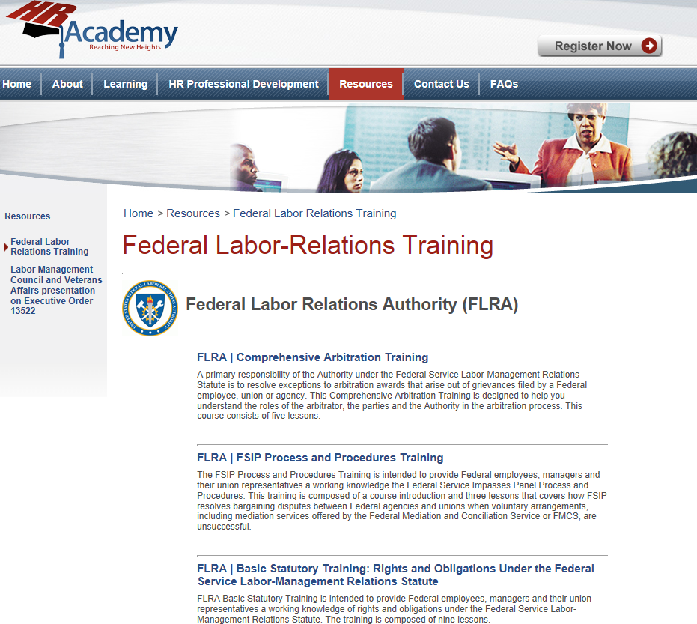
Non-Federal Employees http://www.vahracademy.com/flra.html

Slide 13
