Slide 1
Finding and Applying for Jobs in the Federal Government Instructor Paul M. Plasencia, U.S. Army Retired

Slide 2
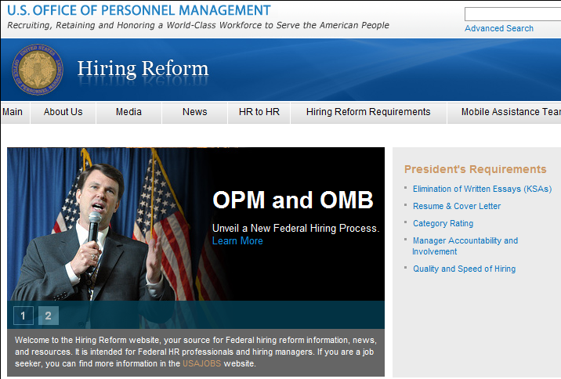
Hiring Reform
Notes:
Read notes not slides
Hiring Reform was announced in May 2010. It was the first time a President directly issued a memo to agencies to make specific changes to hiring processes.
OPM was given specific mandates while the rest of the agencies were given several months to comply.
As of November 1, 2010, many of the changes have been implemented.
Know the audience – if they have never applied before, do not spend much time on what used to be done;
The process has vastly improved and if you have applied before you will immediately see the differences.

Slide 3
Hiring Reform
Why is it a good thing for applicants?
Provides for vigorous recruiting efforts
Makes it easier to apply for Federal jobs
Raises the bar on candidate quality
Maintains Veterans' Preference in Federal Hiring
Provides common sense approach to hiring process
Notes:
Read notes not slides
The initial application is now resume and optional cover letter only and that KSA narratives are eliminated as a FIRST round application necessity (please note they can still exist for later round assessments)
Although KSAs are no longer required it is important to know that you must address the questions in the duty description in your resume

Slide 4
Benefits of Federal Government Service
Public Service – An opportunity to make a difference and influence America’s future
Work/Life Balance
Excellent Advancement Opportunities
Training and Professional Development
Competitive Compensation Package
Abundant diverse career field opportunities with a wide spectrum of Federal missions to choose from
Notes:
Read notes not slides
Among the biggest benefits of working for the Federal Government are interesting work and challenging opportunities. In many professional careers, you may be given more responsibility and autonomy in your position more quickly than you would in private industry.
Another important benefit is the opportunity to “have a life” in addition to having a fulfilling career. Some Federal benefits that support this work/life balance include “flexi-time” which may allow you to work 80 hours in 9 days and have a 3-day weekend every other week; flexible starting hours to fit your home schedule; “flexi-place” or “telework” which allows you to work from home or a non-office location from time to time; and a generous vacation and holiday schedule, which allows you to start with 13 days of annual leave and 13 days of sick leave a year growing to 4 weeks of annual leave PLUS holidays in 3 years..
BACKGROUND NOTES on the Federal compensation package:
Competitive salary with annual (vacation) and sick leave, plus 10 paid Federal holidays a year
Multiple health insurance options, life insurance, and long-term care insurance
The Federal Employees Retirement System (401K-like), plus a supplemental Thrift Savings Plan (pre-tax $)
Flexible Spending Accounts (pre-tax $)
Public Transit Subsidy (non-taxable)

Slide 5
Federal Pay and Advancement
Federal pay is generally competitive across a wide range of occupations
General Schedule (GS) is the primary pay scale for many Federal jobs from Grades 1-15; other pay systems exist
Varies by geographic location (the base salary for GS grades does not change)
Can progress through several grades within a few years of Federal employment
Notes:
5
5
Read notes not slides
Let’s look at the typical Federal pay structure.
As this slide shows, at most federal agencies, salaries are set by the General Schedule (GS), which goes from Grade 1 (GS-1) through Grade 15 (GS-15).
There are 10 steps within each grade, and an individual may move through those steps based on the years he or she is in that grade.
Go to next slide:
Looking at the salary table (NEXT SLIDE) you can see that there are variations in pay based on geography – or, actually, based on the calculated cost of living differential for a locality. For example, the San Francisco area is a high cost of living area, and the pay tables for San Francisco are the highest, reflecting that cost of living.
An employee can move from one grade to the next by being promoted – for example from a GS-7 to a GS-9. Different positions have different rates of promotion, as well as how high you can be promoted before having to apply for a new position at a higher level.

Slide 6
Selected 2012 Starting Salaries
City | GS-5 | GS-7 | GS-9 | GS-11
Atlanta | $32,722 | $40,534 | $49,581 | $59,987
Chicago | $34,316 | $42,508 | $51,995 | $62,909
Dallas | $33,101 | $41,002 | $50,154 | $60,681
Los Angeles | $34,881 | $43,208 | $52,852 | $63,945
New York City | $35,309 | $43,738 | $53,500 | $64,729
San Francisco | $37,073 | $45,923 | $56,172 | $67,963
Washington, DC | $34,075 | $42,209 | $51,630 | $62,467
Rest of U.S. | $31,315 | $38,790 | $47,448 | $57,408
Notes:
6
6
Read notes not slides
May need to explain Steps and grades a bit more here depending on the audience. Point out that salaries escalate quickly as this can be a typical career ladder attained in four or five years.
GS-5 and GS-7 are generally the entry grades for individuals who are college graduates with a Bachelors degree. A Masters student may enter at the GS-9 level depending on relevant work experience.
As you can see from this table, in 2010, an entry-level (GS-7) salary in Atlanta is $40,534, while in San Francisco – which we already noted has a higher cost of living – an entry level (GS-7) salary would be $45,923.
Note to presenter: Make sure you update slide for your location to include that pay scale. Delete NYC to put in your presentation location. Salaries are found at: http://www.opm.gov/oca/10tables/indexGS.asp (mention web link)

Slide 7
Where the Jobs Are: Federal Jobs By Location
In addition, over 50,000 people work for the U.S. Government in foreign countries!
Notes:
7
Read notes not slides
Audience Participation: Depending on the audience, you can ask a variety of engaging questions, “How many of you want to eventually move (or are from) to the east/west coast, south, etc.?” Well you can move there and still work for the federal government.
One myth is that if you want to work for the Federal Government, you have to work in Washington, DC.
However, this map should show that that is not the case. This shows that about 30% of federal jobs are in the Mid-Atlantic region and only 16% of federal jobs are in the Washington, DC area which means that 84% are NOT. NOTE there are over 50,000 jobs overseas, also.
Most federal agencies have regional offices located throughout the country. Many agencies and departments are hiring new employees in these locations – and this may mean you can stay close to home OR go to a part of the country you’ve always wanted to live in!

Slide 8
Where the Jobs Are: Federal Jobs By Occupation
The Federal Government anticipates that future hires for mission-critical jobs will include the occupations listed below:
OCCUPATION
Medical and Public Health
Security and Protection
Compliance and Enforcement
Legal
Administration/Program Management
Accounting and Budget
Information Technology
Notes:
Read notes not slides
You’ve probably heard that currently many individuals in federal agencies are…or will shortly be…eligible to retire. The federal government may need to hire up to 500,000 people over the next five years to replace these retirees and others who leave government. Obviously this “spells opportunity” and lots of it for new feds. (As some of you may have heard because of the current economy many are staying longer—As of today there are currently XXX positions open on USAJOBS)
Hiring is ongoing, although it will expand in the future to meet the needs. This chart shows occupations hiring the most individuals in recent years. The government has identified certain “Mission Critical Occupations” including most of those on this chart where its needs are greatest. However, there are jobs for almost all educational backgrounds, not just the specific occupations shown on the chart.
Later we’ll provide information about some websites that can help you find jobs that fit your training and interests, but let me mention a website now that has over 20 easy-to-use guides for many different majors or disciplines to help you know where to get started in your search. The website is www.MakingTheDifference.org.
This data is from 2007

Slide 9
Special Hiring Programs and Authorities
Veterans
Military Spouses
Students
Individuals with Disabilities
Peace Corps/VISTA Alumni
Notes:
Note to Presenter: For general public presentations, perhaps just mention that these programs exist, and if an audience member falls under one of these categories, they can speak to you after the presentation for more information.

Slide 10
Special Hiring Authorities for Veterans

Slide 11
Special Hiring Authorities for Veterans
Special hiring authorities for Veterans:
Veterans Recruitment Appointment (VRA)
30% or More Disabled Veteran Appointment
Veterans Employment Opportunity Act (VEOA)

Slide 12
Veterans Recruitment Appointment
VRA are for Veterans who:
Are disabled, or
Have a campaign badge, or
Have received an Armed Forces Service Medal, or
Honorably separated from service within the past 3 years
A two-year appointment and training plan for a position, where upon completion, Veterans are converted to a career conditional or career status appointment
Agencies can post job announcements on their website and USAJOBS, but are not required to advertise the position
Agencies can appoint Veterans without competition
Notes:
Agencies can select a veteran from résumés on hand or referral.
Can be appointed under VRA at any grade level up to (and including) GS-11 or equivalent.
This is an exceptive service appointment. After successfully completing two years, veteran is converted to the competitive service.
Agencies can also use VRA to fill temporary (NTE 1 year) or term (More than 1 year but NTE 4 years) positions. If you are employed in a temporary or term position under VRA, you will not be converted to the competitive service after two years.
There is no limit to the number of times you can apply under VRA.
Must provide acceptable documentation of your preference or appointment eligibility. The member 4 copy of your DD21, “Certificate of Release or Discharge from Active Duty,” is preferable. If claiming 10 point preference, you will need to submit a Standard Form 15, “Application for 10-point Veterans’ Preference.”

Slide 13
30% or More Disabled Veteran Appointment
Agencies with a job opening can offer a Veteran the job if the Veteran has a disability of 30% or more
The Veteran must be qualified to perform the duties of the position
When the authority for a permanent appointment, the Veteran is first placed on a time limited appointment of at least 60 days and then converted to a permanent appointment at management's discretion
When the authority is used for temporary or term appointments, the Veteran will not be converted to a permanent appointment

Slide 14
Veterans Employment Opportunity Act
Allows Veterans to apply under merit promotion procedures (can apply to job vacancies that are only open to current competitive service employees)
Applies only to permanent competitive service positions – not excepted service positions.
Notes:
VEOA of 1998 is a competitive service appointing authority that can only be used when filling permanent, competitive service positions. It can not be used to fill excepted service positions. It allows veterans to apply to announcement that are only open to current competitive service employees.
If you are a family member entitled to derived preference, you can apply under this authority as well.
When agencies recruit from outside their own workforce under merit promotion (internal) procedures, announcements must state VEOA is applicable. As a VEOA eligible, you are not subject to geographic area of consideration limitations. When applying under VEOA, you must be considered among the best qualified when compared to current employee applicants in order to be considered. Your veterans’ preference does not apply to internal agency actions such as promotions, transfers, reassignments, and reinstatements.
Current or former Federal employees meeting VEOA eligibility can apply.
You must provide acceptable documentation of your veterans preference or appointment eligibility.

Slide 15
Other Special Hiring Authorities
Veterans should also consider these other special hiring authorities, if eligible:
Pathways Program (students and recent graduates)
Schedule A (people with disabilities)
NOTE: Veterans’ preference does apply

Slide 16
How to Determine your Veterans Preference
Not all Veterans get Preference in hiring
To determine your Veterans Preference use the Department of Labors “Veterans Preference Advisor”
http://www.dol.gov/elaws/vets/vetpref/mservice.htm

Slide 17
Employment Information for Veterans and Military Family Members

Slide 18
Derived Preference
When a Veteran is not able to use veterans’ preference, preference may be given to spouses, widows, widowers, or mothers of Veterans
None may receive preference if the Veteran is living and is qualified for Federal employment
Both a mother and a spouse (including widow or widower) may be entitled to preference on the basis of the same Veteran’s service if they both meet the requirements
Notes:
Spouse – 10 points are added to the passing score or rating of the spouse of a disabled veteran who is disqualified for any Federal position because of a service-connected disability
Veteran – must be unemployed and rated by the military or VA at 100% disabled or unemployable; or has retired, been separated, or resigned from a civil service position on the basis of a disability that is service-connected in origin.
Widow or Widower – 10 points are added to the passing score or rating. Veteran must have died under honorable conditions while serving during a war, or during the period between April 28, 1952 – July 1, 1955, or in a campaign or expedition for which a campaign medal has been authorized. Also, widow or widower must have not divorced from the veteran or remarried. If remarried, the remarriage must be annulled.
Mother of a Deceased Veteran – 10 points are added to the passing score or rating of the mother of a veteran who died under honorable conditions while on active duty during a war or expedition for which a campaign medal has been authorized. She must also have been married to the father of the veteran, and she must live with the totally and permanently disabled husband (either the veterans’ father or her husband through remarriage). OR she is widowed, divorced, or separated from the veterans’ father and has not remarried. OR she remarried, but is widowed, divorced, or legally separated from her husband when she claims preference.
Mother of a Disabled Veteran - 10 points are added to the passing score or rating of a mother of a living permanently and totally service-connected disabled veteran, separated under honorable conditions from active duty, performed at any time, and she is or was married to the father of the veteran; and lives with her totally and permanently disabled husband (either the veteran's father or her husband through remarriage); or Is widowed, divorced, or separated from the veteran's father and has not remarried; or Remarried but is widowed, divorced, or legally separated from her husband when she claims preference.
Preference is not given to widows or mothers of deceased veterans who qualify for preference under 5 U.S.C. 2108 (1) (B), (C) or (2).

Slide 19
Non-Competitive Appointment of Certain Military Spouses
Eligible military spouses can be hired outside of the usual hiring process
3 Categories of Spouse Eligibility:
Relocated with the service member under Permanent Change of Station (PCS) orders.
Service member is 100% disabled due to a service-related injury
Service member killed while on active duty
Military spouses are eligible within 2 years of the PCS orders, or 2 years from the date of the documentation indicating the service-connected disability or death
Notes:
This hiring authority was created to minimize disruptions to military families due to permanent relocation, disability, and deaths resulting from active duty service. Spouses do NOT get a hiring preference or priority, but it allows managers to select them outside of the usual hiring process.
Are all military spouses eligible? No.
The authority allows agencies to appoint a military spouse without competition. Agencies can choose to use this authority when filling competitive service positions on a temporary, term, or permanent basis. The authority does not entitle spouses to an appointment over any other applicant.
Under PCS… You must:
Be authorized to relocate on the PCS orders
Actually relocate to the new duty station
Military spouses can only be appointed within the reasonable daily commuting distance of the new duty station
The appointment must be made within 2 years of the PCS.
NOTE: OPM is proposing to remove the 2-year limit
Under 100% Disability…Eligible if military member:
Retired under Chapter 61 of Title 10, U.S. Code with a 100% disability rating from the military department.
Retired or was released from active duty and has a disability rating of 100% from the Department of Veterans’ Affairs or the military department.
Must provide documentation of service member’s disability
Under death… You are eligible if:
Spouse was killed while on active duty
You are not remarried
Must provide documentation of the death and marital status at the time of death
Military Spouse Preference is a seaprate Department of Defense program applicable to positions being filled both in the continental U.S. and at overseas locations. For more information, contact your local DOD personnel office.

Slide 20
Military Spouses – How to Apply
Apply to any job on USAJOBS and apply non-competitively as a military spouse
State on your résumé that you are eligible under the military spouse hiring authority
May need to submit documentation such as your spouse’s PCS orders, marriage license, etc.
Notes:
Apply on USAJOBS as usual. You can ask to be considered along with everyone else, or non-competitively as a military spouse.
You can use your eligibility once per relocation/PCS order. If your spouse gets another set of PCS orders and have to relocate again, it’s two years from that set of orders.
Spouses do NOT get a hiring preference or priority, but it allows managers to select them outside of the usual hiring process.

Slide 21
Military Spouse Wizard
Use the Department of the Army’s “Military Spouse Wizard” to help determine if you meet the requirements for the Military Spouse Hiring Authority or Derived Preference.
http://www.chra.army.mil/webcourses/Mil_Spouse_Wizard/index.html

Slide 22
Veteran Employment Information www.FedsHireVets.gov
Notes:
This is the Federal Government’s sole source of consistent and accurate information on Federal employment for veterans. It is a result of President Obama’s Veterans Employment Initiative, Executive Order 13518.

Slide 23
Hiring Programs for Students and Recent Graduates
Notes:
Are you a student or recent graduate looking to make a difference by working for the Federal government? The Federal government is comprised of over 300 agencies with jobs for nearly every interest you may have. For student and recent graduate audiences, this is one of the most important and relevant sections of the presentation, as these programs are specific to these audiences. Many veterans are using the GI Bill or other VA educational benefit to attend school.

Slide 24
Pathways Programs
Executive Order 13562: Recruiting and Hiring Students and Recent Graduates (issued December 27, 2010)
Establishes a Pathways framework with three clear program paths for students and recent graduates:
Internship Program
Recent Graduates Program
Presidential Management Fellows Program
New programs will not be implemented until regulations are final
Veterans’ preference will apply to these programs
24
Notes:
24
On December 27, 2010, President Obama signed Executive Order 13562, entitled “Recruiting and Hiring Students and Recent Graduates.” This Executive Order establishes a Pathways Programs framework with three clear excepted-service program paths tailored to recruit, hire, develop, and retain students and recent graduates. It lays the groundwork to improve recruiting efforts; offers clear paths to Federal internships for students from high school through post-graduate school and to careers for recent graduates; and provides meaningful training and career development opportunities for individuals who are at the beginning of their Federal careers. The three program paths included in its framework are: an Internship Program, a Recent Graduates Program, and a reinvigorated Presidential Management Fellows (PMF) Program. Final rules to implement Pathways will take effect on July 10, 2012; for more information, you can visit: www.opm.gov/hiringreform/pathways.

Slide 25
New Pathways Programs: The Way Forward
Internship Program – open to students enrolled in a variety of educational institutions
Recent Graduates Program – two-year career development program for recent graduates who have completed their degree within the preceding two years (six for qualifying Veterans); hired in cohorts aligned with academic calendars
Presidential Management Fellows Program – a reinvigorated, 2-year leadership and development program, aligned with academic calendars, for individuals who have received a qualifying advanced degree within the preceding two years
25
Notes:
25
The three program paths included in Pathways are: an Internship Program, a Recent Graduates Program, and a reinvigorated Presidential Management Fellows (PMF) Program (note: explain each based on the text included on this slide).
Note to Presenter – make a note that Veterans Preference also applies to these Pathways Programs.

Slide 26
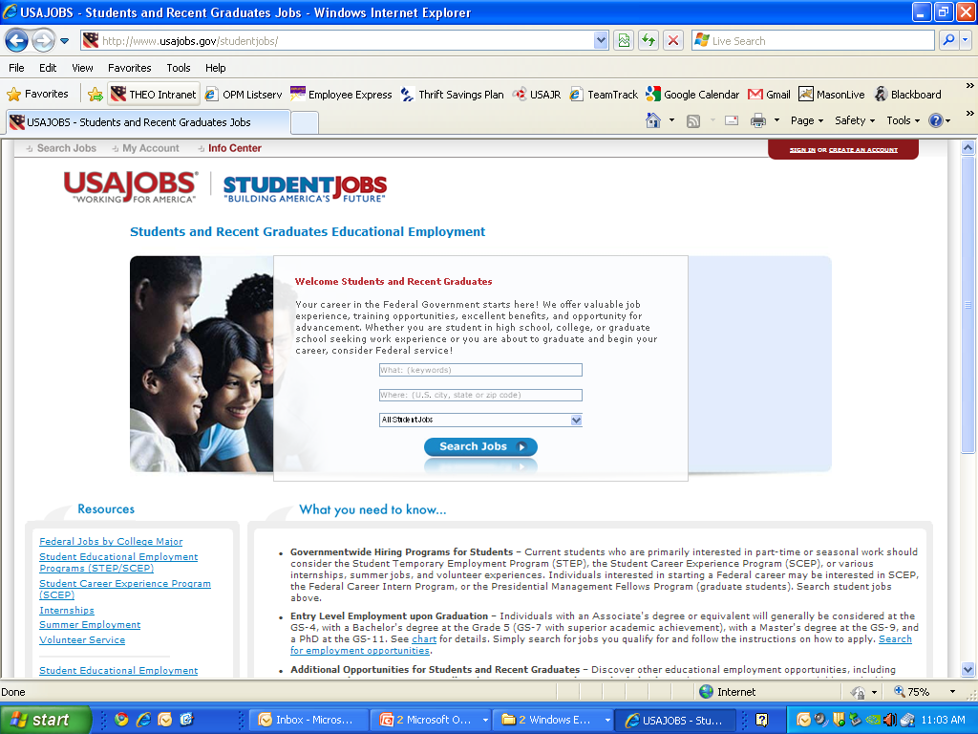
Where to Look for Student Positions
Student Jobs Web site
Your Career Center or Academic Advisor(s)
Individual Agencies/Contacts
26
Notes:
26
So, how do you find these opportunities? While not an exhaustive list, I can offer a few tips for how to find these opportunities. While not all available student positions are included on this site, the search engine on the web page displayed here, www.usajobs.gov/studentjobs (i.e., the students sub-page of USAJOBS), will help you navigate those positions agencies have decided to post here. You can also inquire about Federal student opportunities by checking with your school’s career center and/or academic advisor(s), or contacting directly the agency(s) at which you wish to work. If you ever have the opportunity to attend a career fair hosted by school, this also represents an excellent opportunity to inquire about student positions as you are visiting the various Federal employer booths.

Slide 27
Hiring Program for People with Disabilities

Slide 28
Schedule A Hiring Authority
Applicants with a disability can be hired under a non-competitive hiring authority called “Schedule A.” This occurs outside the usual hiring process
Eligible disability categories:
Intellectual
Psychiatric
Severe Physical
Veterans’ Preference applies to Schedule A, and disabled Veterans should consider applying under this authority if eligible
Notes:
Schedule A Hiring Process Requirements
You have to have a disability that falls into one of three categories: An intellectual disability, a psychiatric disability, or a severe physical disability.

Slide 29
How to Apply under Schedule A
Go to USAJOBS, find a job you like, and apply
State on your resume that you are eligible under the Schedule A Hiring Authority
Submit a copy of your “Schedule A” letter stating you have a disability and “Certification of Job Readiness” stating you are likely to succeed at the job for which you are applying
Contact agency’s Selective Placement Program Coordinator for guidance
Notes:
Applying for Jobs using Schedule A (for people with disabilities)
How do you find these jobs? You won’t necessarily find jobs listed under Schedule A. Schedule A is just a shortcut name for the hiring authority an agency can use to hire people with disabilities for any job.
Search for jobs you might be interested in on USAJOBS. Search for locations where you’d like to work, and for jobs you believe you can do based on your knowledge, education, skills and so on.
You will need a letter stating that you have a disability that will also include certification of job readiness. We call it the Schedule A Letter. It can come from a licensed medical professional, a vocational rehabilitation specialist, or from any federal or state agency that issues or provides disability benefits.
Most agencies have Selective Placement Program Coordinators that are often in their Human Resources Office. These are people who will help you navigate though the agency’s hiring process.
Agencies often have their own rules about job readiness so contacting the Human Resources office or the Selective Placement Program Coordinator could save you some time.
OPM has a list of Selective Placement Program Coordinator’s on our website at http://www.opm.gov/disability/SSPCoord.asp

Slide 30
Obtaining Letters
“Schedule A” and “Certification of Job Readiness”
Both letters can be combined or separate and obtained from:
Licensed medical professional
Vocational rehabilitation specialist
Federal or state agency that issues disability benefits
Sample letters are available on USAJOBS www.usajobs.gov/individualswithdisabilities.asp
Notes:
Samples of these letters are on USAJOBS. On the home page, there is a link for Individuals with Disabilities.
Once you find a job you’re interested in, let the agency know you’re eligible for Schedule A by submitting a copy of your Schedule A letter and your Certification of Job Readiness with your resume.

Slide 31
How to Find and Apply
Searching for Federal jobs
Creating your account and profile (including resume)
Managing your account
Reviewing job opportunity announcements
Submitting applications
Following-up on application status
2

Slide 32
Before You Look and Apply
Determine what Federal positions you qualify for based on your experience.
www.mil2fedjobs.com
Determine what Federal positions you qualify for based on your education.
www.usajobs.gov/studentjobs select “Federal Jobs by College Major”
Federal Qualification Standards
http://www.opm.gov/qualifications/standards/indexes/num-ndx.asp
Not sure where to start.
http://www.vaforvets.va.gov/ “Click on Career Center
Notes:
Before you even start looking for federal positions its very important to determine what federal positions you may qualify for.
The 3 links provided above will assist and help you to search for and apply only to those positions you may qualify for based on your education and / or experience.

Slide 33
What to Expect Next
Notification your application has been received by agency
Agency will review eligibility and qualifications
Agency may conduct additional assessments
Agency will rank candidates based on qualifications
Agency may conduct interviews
Agency will select the best candidate for the job
Applicants will be notified of selection or non-selection by agency
15
Notes:
The “What to Expect Next” section in the job opportunity announcement includes specific information about the job opening. Basically, the steps are the following:
The hiring agency will provide notification that your application has been received.
The hiring agency will review all applications to identify applicants who meet the basic eligibility requirements (e.g., U.S. Citizenship) and the job-related qualification requirements. You may receive a notice as to whether you met these requirements.
Applicants who pass this initial screening are eligible to take the selection assessment(s). A selection assessment may be delivered in a number of formats, for example: assessment center, structured interview, multiple choice written or online test, work sample. If a selection assessment is a part of the hiring process it will be stated in the Job Opportunity Announcement. Selection assessments identify the best qualified candidates for the job.
After conducting the selection assessment(s), the hiring agency will place applicants in one of two or more quality categories such as, “Best Qualified”, “Well-Qualified”, and “Qualified”. The names of the categories vary across agencies. There must be at least two categories.
Candidates in the highest quality category are referred to the hiring official. From this list, the hiring official may choose candidates for interviews. Applicants may be notified that their name was or was not referred to the hiring official.
The hiring agency selects the best candidate for the job.
Applicants will received a notice whether they were selected or not selected.

Slide 34
Creditable Service for Annual Leave
The head of an agency, or his or designee, may at his or her sole discretion provide service credit that otherwise would not be creditable under 5 U.S.C. 6303(a) for the purpose of determining the annual leave accrual rate.
The agency must determine that the skills and experience the employee possesses are-
Essential to the new position
Were acquired through performance in a non-federal or active duty uniformed service
Duties relate to the duties of the position to which being appointed
15

Slide 35
A Note About Security Clearances
Most individuals selected for Federal positions will be required to undergo a basic background investigation
Jobs that require access to sensitive information require a security clearance which is more extensive than a background investigation
16
Notes:
35
Some jobs require a security clearance because the work will include access to sensitive information or access to areas containing sensitive information. Most often, the clearance process takes place after a tentative job offer has been made and accepted. Most job offers are contingent on a favorable background investigation.
Even if a job does not require a security clearance, everyone goes through some level of investigation.
It is imperative you are honest about your background during this process. If it is later discovered you withheld information, purposefully attempted to deceive or “mask” negative information, or provided false information, you may be fired.

Slide 36
Tips for Applying
Focus Your Search - find jobs that best match your interests for which you are likely to be qualified
Plan ahead – take time to carefully prepare your application
Follow-up on the status of your application
19
Notes:
36
36

Slide 37
Questions

Slide 38
Contact Information
Paul M. Plasencia
Veterans Employment Program Manager
U.S. Department of Labor
Office of The Assistant Secretary for Administration and Management
hiringvets@dol.gov

